Slide 1
Letter from the Napoleonic Wars
1795

Slide 2
This complete letter dated 16th January 1795 is addressed to Mr Samuel Mellish, Victualling Officer, Portsmouth, and has been sent from his parents Peter and Mrs Mellish of Shadwell Dock, London.
The two page letter is written on handmade paper and the watermark is still visible when the letter is held up to the light. The watermark on the paper shows that it was made by a company owned by a Mr James Whatman, who was a master of western paper making.

Slide 3
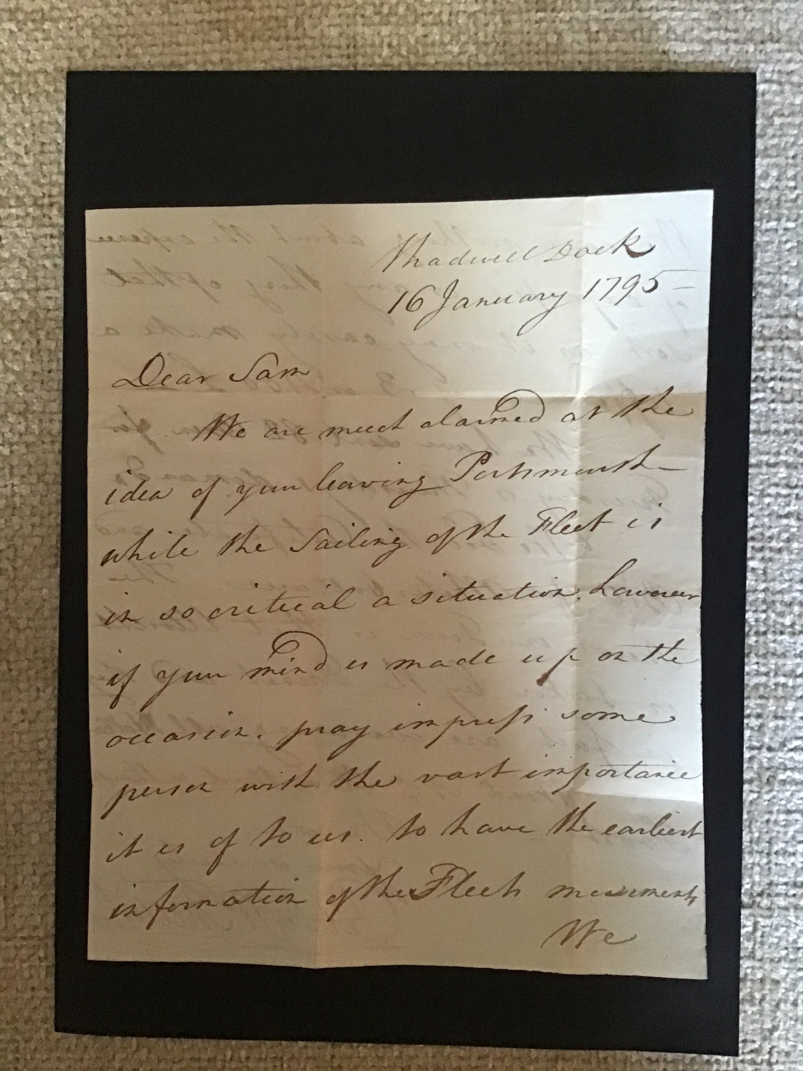

Slide 4
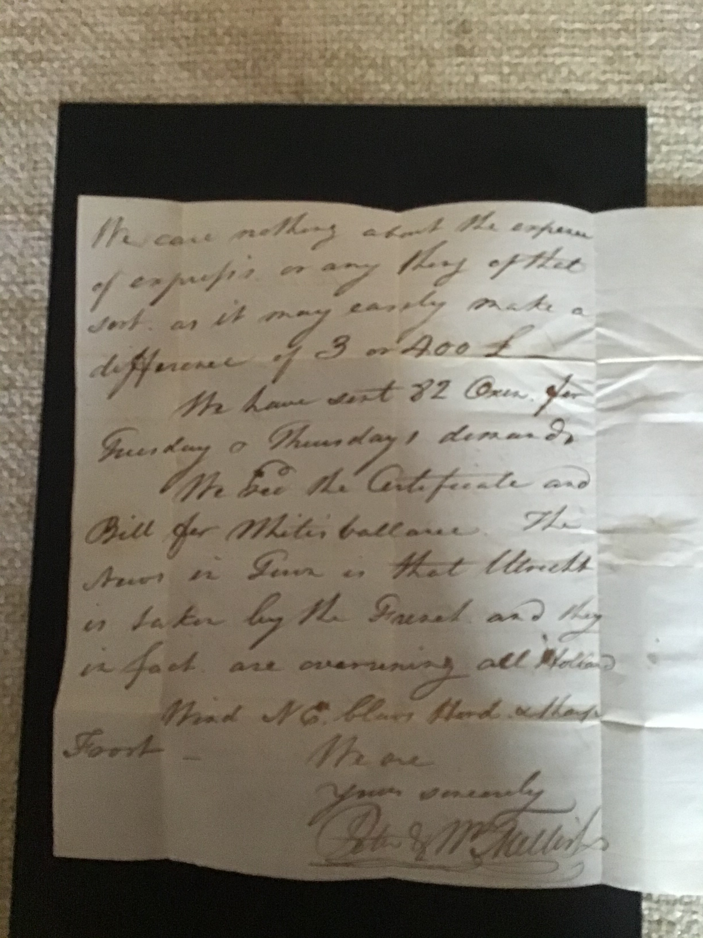

Slide 5
Mellish Family Estate
William Mellish (c. 1763–1834) was an English businessman who was involved in supplying the Royal Navy, particularly during the American War of Independence. He also owned or partly owned a number of whaling ships.
For much of his career, he was in business with his brother Peter Mellish who has sent this letter Their father, Peter Mellish, Sr. had been a butcher in Shadwell, and they bid to supply the Navy with beef under a competitive tendering procedure. Thus, for example, in 1794 they won the contract to supply 3,000 head of oxen for sea stores.
Peter Mellish of Shadwell was one of several eighteenth-century butchers who owned or rented pasture on the Isle of Dogs, buying more than 30 acres on the east side of Marsh Lane in 1772. After his death in 1777 his sons Peter and William became victualling contractors to the Royal Navy, and developed a substantial business as agents and shippers, based at Shadwell Dock. In 1784 Peter bought 16 acres on the other side of the lane, with a good river frontage, from the Commissioners for Victualling the Navy, who had acquired it a few years earlier. Further land was bought by Peter, some of it conjointly with William, and after Peter's death in 1803, his brother continued to buy.
The Mellish Estate, was built up by a series of purchases over a half a century, and eventually became the was the largest private estate in Poplar. Despite its size it was, apart from a small portion, of little importance in the early decades of the industrialization of the Isle of Dogs. It was bought almost entirely for grazing, not for speculation, and was ill-placed to take advantage of the opportunities for development which followed the opening of the West India Docks. The land — which comprised 209 of the 355 acres of pasture in the parish in 1828–35 was nearly all on the east, less well favoured, side of Potter's Ferry, with little riverfront in Millwall.

Slide 6
Letter Contents
The two page letter, expresses concern at the idea of the recipient’s leaving Portsmouth while the ‘sailing of the fleet is in so critical a situation’.
The letter relates to a major event at the time stating ‘the news in Town is that Utrecht is taken by the French and they are in fact overrunning all Holland’.
The news at the time from the Napoleonic War was that Utrecht had indeed been taken by the French and on the 1st January 1795 Utrecht surrendered to French forces.

Slide 7
Historical Context
Just a few days after the writing of this letter, the capture of the Dutch Fleet at Den Helder or the Battle of Texel occurred on the night of the 23rd January 1795, and presented a rarer occurrence of a naval battle between warships and cavalry.
A French Hussar regiment surprised a Dutch fleet frozen at anchor between the port of Den Helder and the island of Texel. After an extraordinary charge across the frozen Zuiderzee, The French cavalry captured 14 Dutch ships and 850m guns.
This capture of ships by horsemen is a unique feat in military history.

Slide 8
Request in the Letter
In the letter Peter and Mrs Mellish state that they want to know as soon as possible how many oxen the navy require. They are not worried if the navy wants the oxen more quickly as presumably there is clause in the contract where they are paid more nonet for a fast service.
They have sent 82 oxen for Tuesday and Thursday and these oxen would have been driven to Portsmouth on droving roads that were common across England, Wales and Scotland at the time. Corgis were used to help with the driving of the oxen as they are good herding dogs and nip at the feet of larger animals to keep them moving!

Slide 9
The weather In January 1795
The letter also tells us that the wind from the NE is blowing very hard and that there has been a sharp frost.

